Slide 1
Project: Home Renting Management System (using JAVA)
Developed By:
Sayanta Chowdhury
Level-2 Term-II ID:105079 Section:B
Mahedi Hassan Sharif
Level-2 Term-II ID: 1105061 Section:B
Daud-ul-Islam
Level-2 Term-II ID: 1105076 Section:B

Slide 2
Our Vision:
Advantages:
This Project is developed for making our local Home renting system very easy.
The Owners and the clients both people can get previlage by this project.
Clients can know about the home rent news anywhere.
Owner can spread the home renting advertisement using it.
The difficulties of the client will be reduced
Owner could spread his renting news more quickly using it

Slide 3
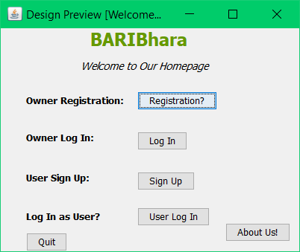
How to use it?
First of all every owners and Client or Users have to registered in the site.
Then they have to logged in this.
Then they can use further functionalities.

Slide 4
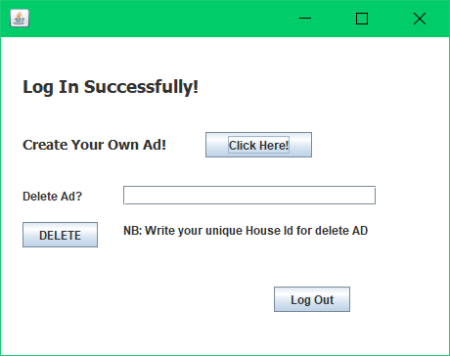
Log In as Owner:
When someone logs in as the Owner then he can create the advertisement of about his Home-renting news.
Also he can delete his previous home-renting advertisement.

Slide 5
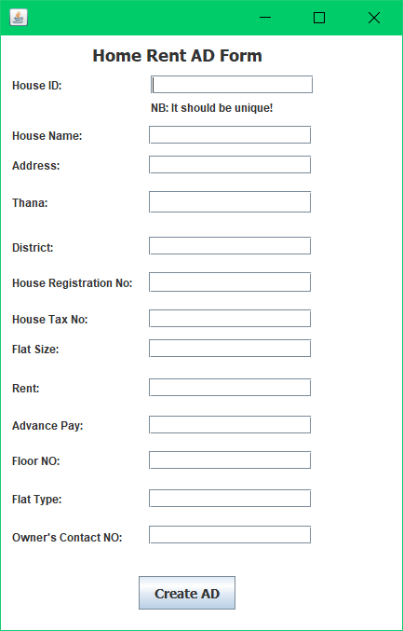
Create Advertisement:
For creating Home-renting ad he have to use unique HouseID.
Also he must fill the form carefully so that he does not fall in any misunderstanding.
He have to fill the all text filled otherwise it will show failed message.

Slide 6
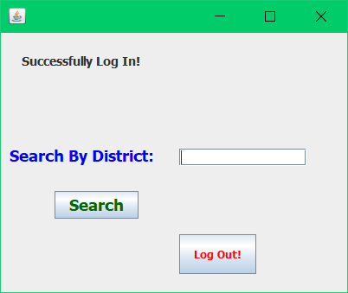
Log in as Client or User:
When someone logs in as the Client or User the he can search the home rent Ad using District keyword.

Slide 7
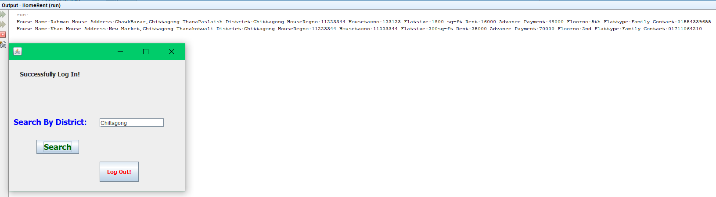
After Searching:
When he perform Search option using district he can see the results in output bar.

Slide 8
Our Mistakes:
We failed to make the project a web application
The User’s or Client’s search result failed to show up in Jframe Form
We failed to use a keyword other than the District Keyword in the search bar.
We failed to make the password encrypted.

Slide 9
Thank You.
That is all about our JAVA Project.

